Slide 1
Spotlight on ADS
Marketing and Communications:
Turning Small Steps into Big Strides
Notes:
Thanks, Lance! And Hello everyone, thank you for joining us. Today we will be talking about using your website and social media to promote your ADS center.
We have a lot of ground to cover, but we’ll try to leave some room for Q&A so you can put your questions in the chat box and we will go over those at the end.
So let’s get started.
.

Slide 2
Goals for this session:
Review the survey results
Introduce a new 4-step marketing program
Focus on other core best practices

Slide 3
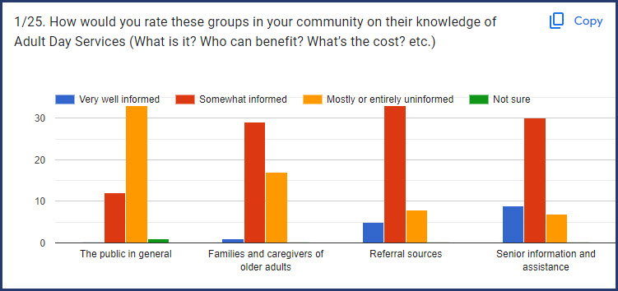

Slide 4
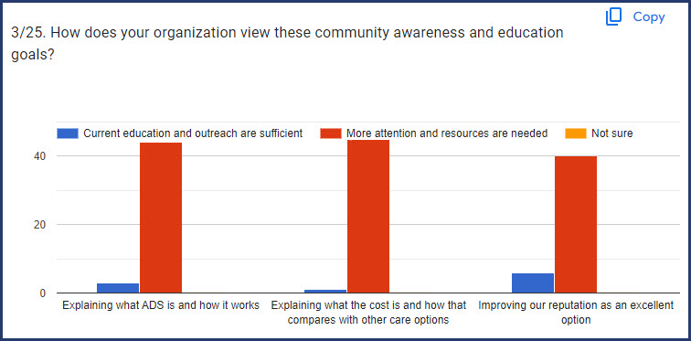

Slide 5
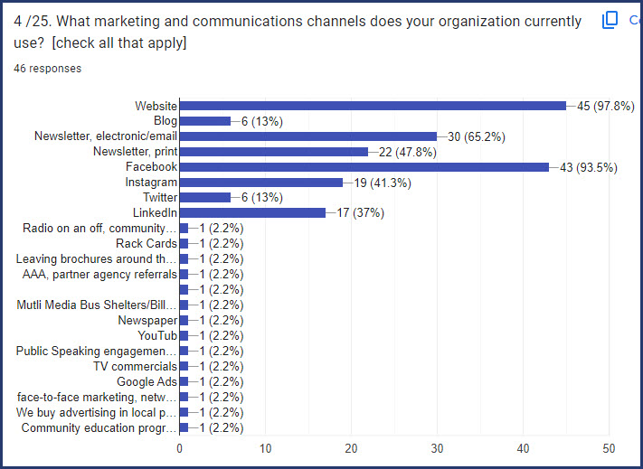

Slide 6
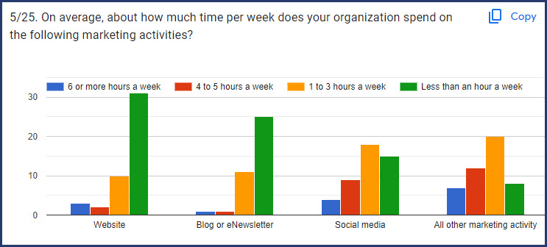

Slide 7
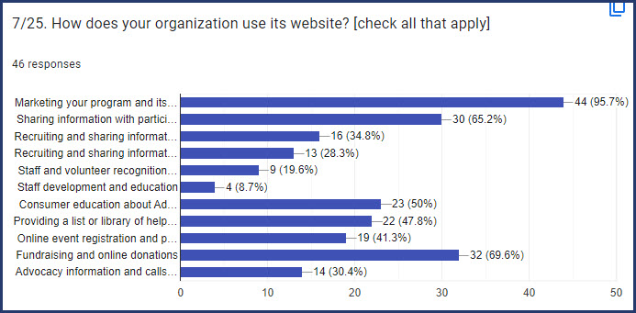

Slide 8
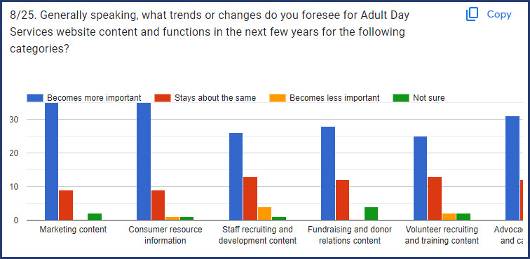

Slide 9
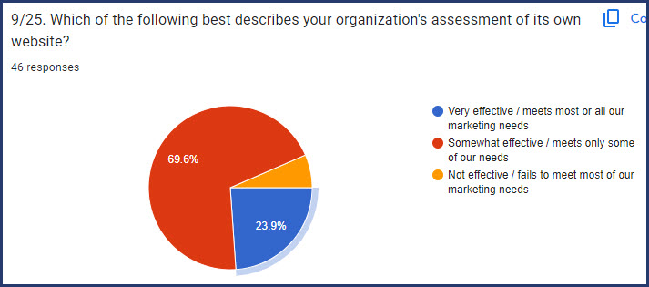

Slide 10
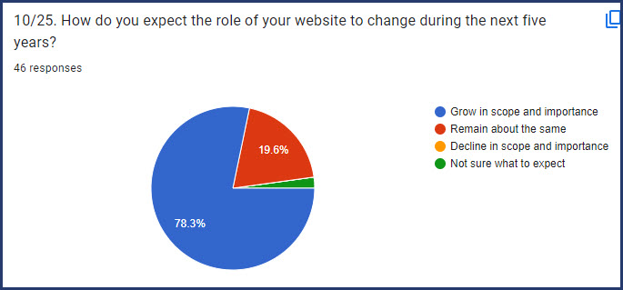

Slide 11
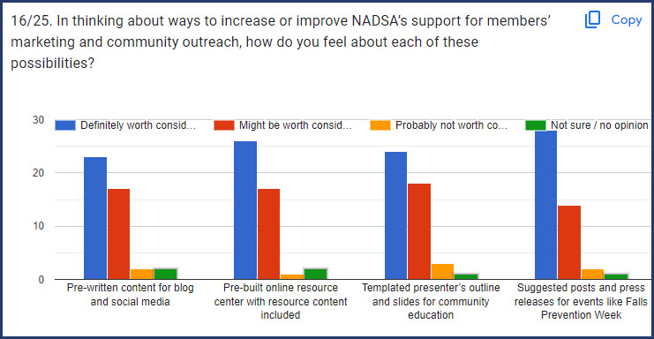

Slide 12
A low-cost, four-step marketing program for NADSA members

Slide 13
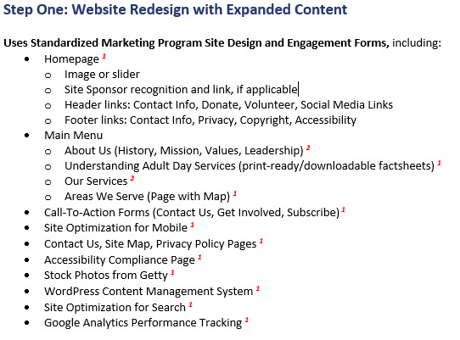

Slide 15
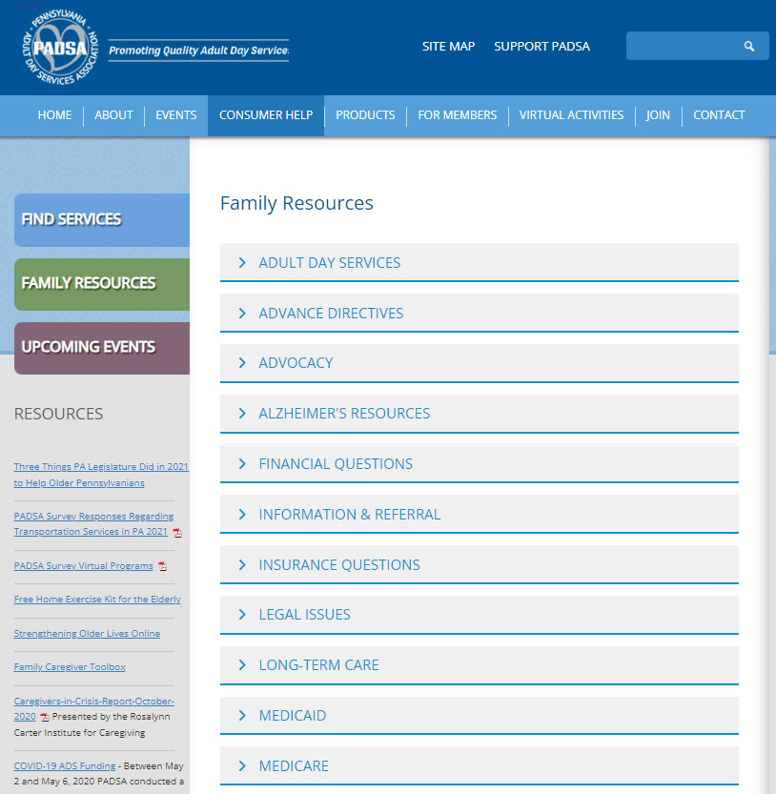

Slide 16
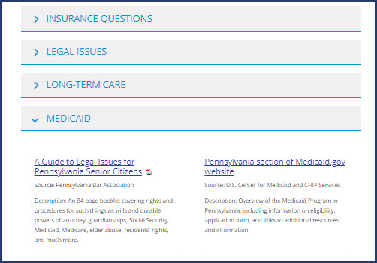

Slide 17
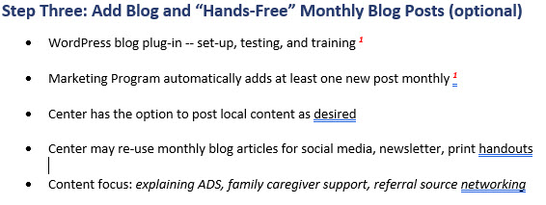

Slide 20
Other steps toward an efficient, sustainable program of marketing and community outreach

Slide 21
What is Digital Marketing ?
“Any marketing methods conducted through electronic devices which utilize some form of a computer.”
Key difference from non-digital marketing: Interaction
American Marketing Association
Notes:
Your website and social media programs are important parts of your overall digital marketing program. So what is digital marketing?
Here’s a good definition from the American Marketing Association: it basically involves any marketing online through a device such as a smartphone or computer.
So that includes websites, search engines, blogs, social media, email, etc.
What differentiates digital marketing from non-digital (such as billboards or print ads) is that digital allows immediate interaction between your center and your prospects– wherever they are.
And as fantastic as interaction is, that’s only ONE benefit of digital marketing.

Slide 22
Benefits of Digital Marketing
Allows direct, immediate interaction
Increases visibility and pulls people to your website
Sustains brand recognition and reputation
Differentiates you from the competition
Helps with staffing
Notes:
Here are a few more benefits of DM that can help you to build and promote your centers:
1st Benefit is Visibility. Social media, blogging, emails, all those things, increase your visibility and help prospects take action, which might include visiting your website, making a phone call, filling out a form, etc.
Brand recognition and reputation – When you have an active online presence, people can recognize your center name or your logo, and perhaps you or your other employees. Getting and sharing positive reviews or feedback is a great way to enhance your reputation. And Connie will talk about that later.
DiffeRENTiation – This is closely related to brand recognition. Everything you do in digital marketing, just as in traditional marketing, reflects who you are - compared to other companies. Thinking about what differentiates your center is an important exercise—maybe it’s the services you offer, your staff training, or your location. Know your differentiators and use digital marketing to claim your space and build your reputation.
Staffing - Many of our clients use digital marketing to advertise open positions. You can also use digital marketing to celebrate your team, which is a great way to enhance both your brand recognition and your image as a desirable employer.
So, those are some great benefits of digital marketing. Of course, this is not to say that your other marketing efforts are not important – things like networking, community outreach and sponsorships do matter. A well-rounded marketing program will include those face-to-face connections, but it’s hard to grow your business without digital marketing.
OK, now that we’ve got that basic intro about digital marketing and its benefits, we’re ready to share some of our best practices!!

Slide 23
What We Will Review
What is Effective Website Design
How to Maximize Social Media
Using Citations & Google Business Profiles
Notes:
So Here are the 3 areas we are going to focus on today and share some best practices on….
Effective Web Design
How to Maximize Social Media program
Using Citation updates & Google Business Profiles

Slide 24
Your Website Current & Compliant
Does it remind us of ‘Back to the Future’?
Do you have current photos and info?
Is it responsive?
Is it ADA compliant?
Notes:
Your our website is going to be one the first places people are going to look at during the research process and serves as the backbone and the Hub of your online presence.
Does your website remind us of ‘Back to the Future’?!
We recommend to our clients a redesign of their websites every 3-5 years and this is to ensure that they are staying with current trends and functionality.
Do you have current photos and info? Making sure your info is up to date and you don’t have old posts, photos or news that make your site look dated. Having testimonials is another great way to share peer experiences and bring a personal element to your site.
Is it responsive and Mobile friendly– On average of 50% of users will view your site on their phones. Make sure your site displays well across all screen sizes.
Over the last few years we have seen an uptick in the rules and regs regarding ADA compliance – ensure that your website user friendly for all users.
So to summarize --- You control your story and your message through your website with your photos, design and content and make sure these are all in line to put your best foot forward and a making a great first impression!

Slide 25
Your Website Conversions
SEO
Calls to action and forms
Effective Content
Notes:
One of the main purposes of your website is convert your visitors into clients right?. So, In order to this you need to have a few essential elements. The first one being solid foundational SEO. Your website provider is probably already going to add your meta titles and descriptions but we like to remind clients to include a page on their website that can be optimized for each key search term they want to rank for.
Using FAQs on your website is a great opportunities to answer questions for your audience and it also helps you to be found for those questions in search results.
Another best practice is --you always want to mention your service areas because that text or web copy on your site is going to support your SEO goals for ranking in those areas you serve and helps you come up in search.
Another essential element of your website that people sometimes miss – is clear calls to action and forms. First what is a CTA? call-to-action is the part of a webpage, or piece of content that encourages the audience or users to do something such or take action as calling or filling out a form for more information. Your call to action (CTA) is the chance to motivate your audience to take real steps toward becoming a customer or client.
Finally, Keeping your website updated with fresh content is a great strategy for connecting with your audience and supporting your SEO goals, this can be done with news, calendar updates or a blog. Search engines and social media platforms alike love content, and any content that drives them and visitors back to your website is good for you and yout SEO efforts.

Slide 26
Content
What is Effective Content Marketing?
Content Planning
Notes:
Content is a key element that ties many facets of your marketing together. it’s important for your website to have great content to educate visitors about what you do and support SEO efforts (like we talked about). It’s also good for your website to have regular content updates, and your social media program will rely on great content. So what is effective content marketing, and how do you make a plan that allows you to produce it on a regular bases and be consistent about your posting??

Slide 27
Effective Content Marketing
Be helpful to the reader
Reflect your credibility and expertise
Support search engine optimization (SEO)
Be shareable and interesting
Notes:
SO what is Effective content Marketing?
You can help the reader learn something, give them something useful and maybe help them learn about ----- an elder care situation they are in –or - tips on care for a loved with dementia for example -- this would probably be useful to many of your families you serve.
Effective content should reflect your credibility and expertise by showing that you know both your customers’ and prospects’ concerns and have answers and resources to help.
It should support search engine optimization (SEO) by using the keywords people use to search for your services. For example, the phrases “ADS center” or “Adult Day” should be used a lot on your website. That will make you more likely to show up in search results for those key terms.
And finally, your content should be interesting and shareable – because by getting your content shared means youre increasing your visibility and you can tell your meeting your goal of being a rescource for your audience. This is going to translate into greater reach, more followers, and more leads for your center.

Slide 28
Content Planning
“The” calendar
Activities calendars & menus
Organization highlights
Common questions & stories
Community resources
Notes:
Generating content for your digital marketing program can seem a little daunting at first but it is a lot easier if you have a plan. So I am going to share five areas that you can organize your content calendar around:
“The” calendar – is our name for the general calendar of holidays and healthcare remembrance dates that are generally relevant in healthcare industy. Our content team updates this annually with links to the sponsoring organizations. In this calendar you will find:
remembrance dates, like cna week, which are great times to highlight different members of your team as well as family caregivers day, which is a great time to honor the families you serve, or national adult day services week, which is a great time to celebrate all that you do. If you email us after the presentation, we would be happy to share our 2023 calendar with you to get you started!
Your activities calendar
Your activities calendar & menus, which are great to post on your website. It’s also nice to feature pictures from your activites on social media so that current and prospective families can see the type of care you provide and everyday life looks like.
Organization highlights
Organization highlights can be a number of things – you could feature different pages of your website on social media to educate the public on what you do, you could celebrate new team members or staff anniversaries, and of course, any awards or recognition you might receive.
Common questions & stories
Are there things that families regularly ask you? Those type of things would be great blog posts! Have a family member shared a great experience with you – ask them for permission to share it on your website and social media as a testimonial.
Community resources
It’s nice to share things that you see going on in the community, such as an Alzheimer’s support group, even if it’s something youre not directly involved with. It helps those you serve find resources they might be interested in, and it promotes your community partners.
And now we are going to do a quick review of some content samples.

Slide 29
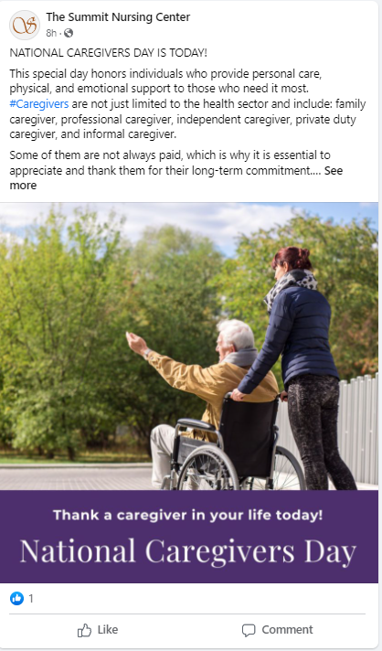
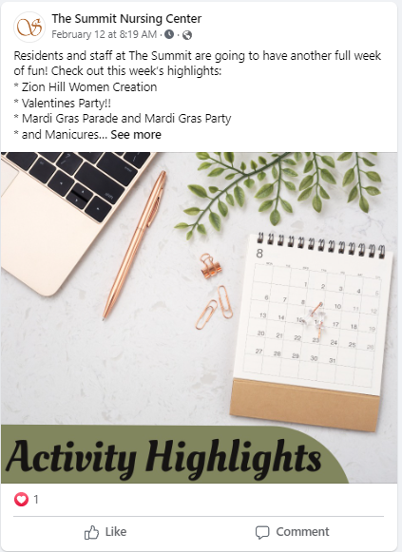
Notes:
Here are two examples fb posts the first one highlights National care givers day this is a great remembrance date to highlight and the 2nd is an internal activity calendar post –sharing out what fun activities are going on at there center this week!

Slide 30
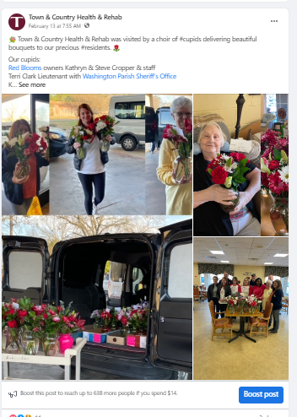
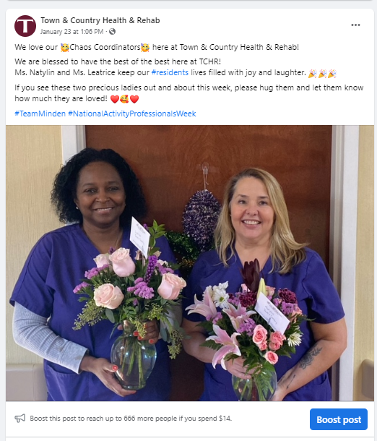
Notes:
Here are two more posts the first is Vday community event and the 2nd is a staff celebration or staff recognition. People love this local content!

Slide 31
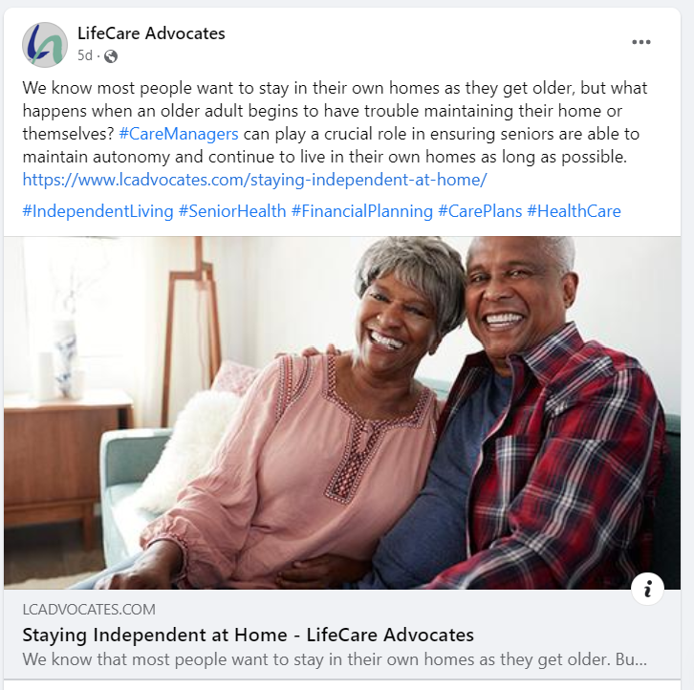
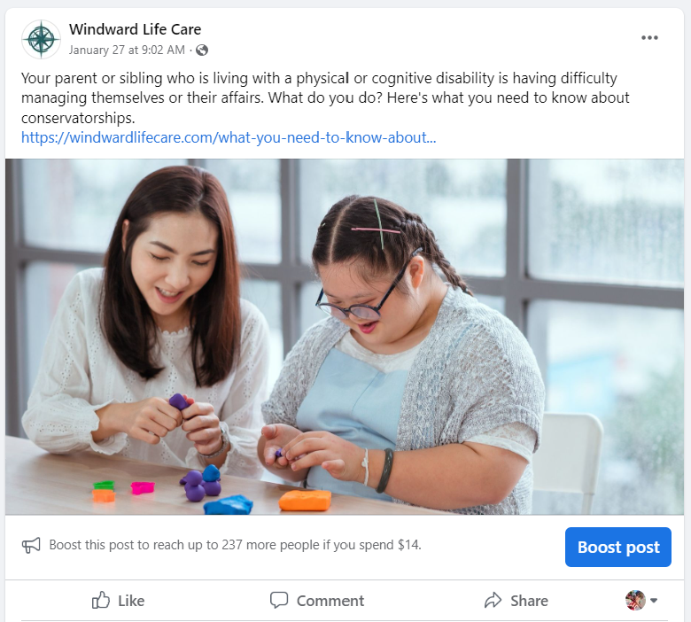
Notes:
Here we have to posts sharing a community resources and highlighting their service page that links back to the website ( for some grat visibility) and the 2nd is a commonly asker questions ( being a resource to their community ) also linking back to their website. These are all great examples of effective content marketing and they’re examples of how you could use this content to promote your centers. And with that I am going to pass it off to Connie to dive into social.

Slide 32
Social Media Platforms
Facebook
Instagram
Google
LinkedIn
Notes:
Thank you Mary. So now comes the fun part! Now that we have content, let’s talk how we are going to use it. Longer form content and resources are going to be posted to your website then make it’s way over to social media, and much of your day to day content is going to go straight to social.
We recommend Facebook, Instagram and Google Business profile as primary social media platforms for adult day centers to use for consumer marketing.
Facebook is a great place for adult day centers to connect with families, community partners and employees. It’s a great place to show off what your center offers to your current network and engage them to amplify your message for people that are in their respective networks, but not yours, yet! Facebook still has the largest market share, especially in an older demographic which comprises our target market of adult children and referral sources. Instagram has a younger demographic, but it follows FB in market share and is trying to claim a space in social video.
We recommend google to all of our clients because google gets the lions share of search traffic. Updating your google profile ensures that your info on search is correct, posting your content to google can help you in local search, which is an important goal for most clients. It’s also the place where people will see and give you most of your reviews, . Reviews are import for seo and also influence conversion, so encouraging searchers to take the next step.
LinkedIn as a strong tool for community networking – from cultivating referral sources to attracting employees, donors and volunteers. On LinkedIn, you will need to cultivate at least a personal profile, but likely a center profile.

Slide 33
Google Business Profile
Description
Name
Service Categories
Address
Notes:
Now, you’ll notice that engagement thus far as focused on FB, but we mentioned Google Business when we recommended platforms. We recommend managing your google profile because that’s one of the most common & visible places for online reviews and because your activity there can positively influence your search rankings. Google allows you to fill in your basic business info, such as name, address, services offered and use the category adult day care center

Slide 34
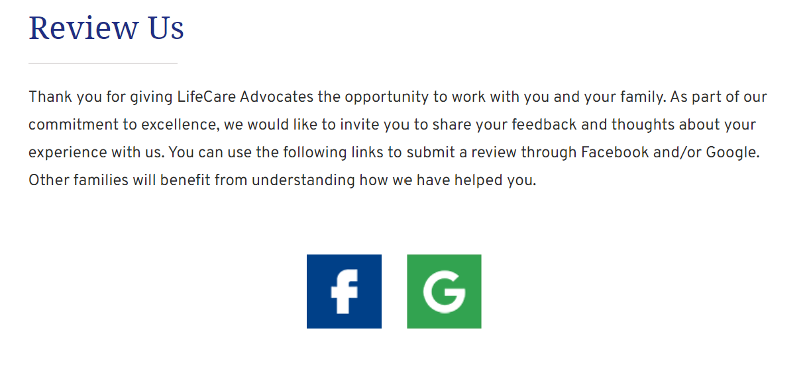
Google Business Profile
Reviews
Posts
Notes:
if you want to step up your local SEO game, getting reviews and sharing posts is your next level. You can create a simple page on your site to help people find your review platforms, as seen here. These icons link directly to your review source, so it makes it easy for families.

Slide 35
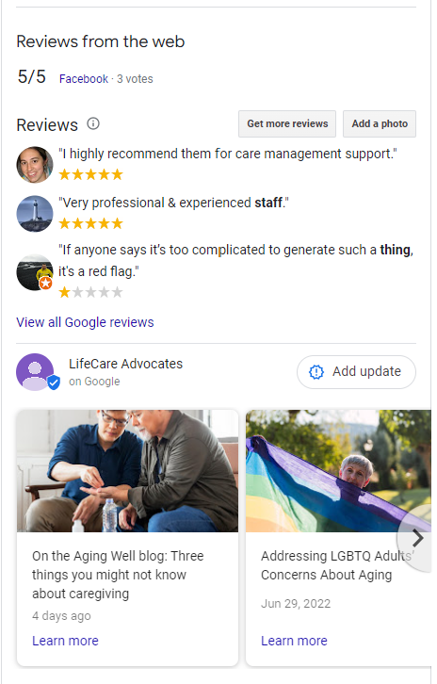
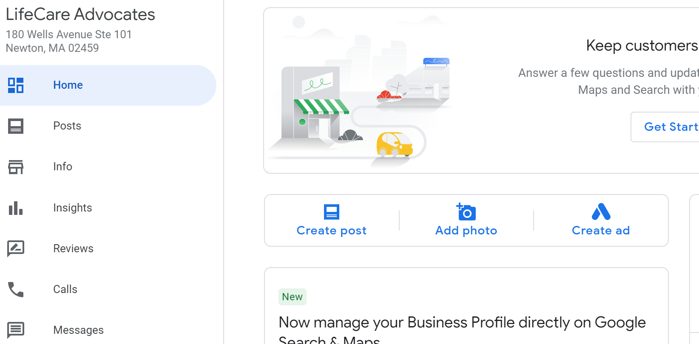
Posts & Reviews
Notes:
You can respond to your reviews and post to your google profile from the business profile manager or directly from search, as see here as long as you are logged into your profile. Calendars are a great and easy thing to share out to google on a regular basis.

Slide 36
What’s Next?
Website Best Practices
Google Business Profiles (Citations)
Maximize Social Media
Notes:
So what do you do next? That depends on where you are. If you are new to the digital marketing, then start by doing a solid evaluation of your website to make sure it’s in good order. Then claim your google profile and get your social media profiles in order.
If you are further into your digital marketing program, start looking for creative ways to up your content and social media game. You can also evaluate your search engine ranking and consider whether paid search might be a good fit.

Slide 37
Get In Touch.
Website:
Mary Donahue:
Dennis Kenny:
www.illuminAge.com
Phone: 206-347-1855
Email: Mary@illuminAge.com
Phone: 206-347-1868
Email: Dennis@illuminAge.com
THANK YOU!
Notes:
We’re here to help. Feel free to reach out with your questions, goals, or concerns and we will offer you recommendations for a path forward, whether we are a part of that path or not.
Questions:
What about social media management software?

